Slide 1


Slide 2

AI-Powered Smart Health Assistant
An Intelligent Symptom Analysis and Preliminary Health Guidance System

Slide 3
Student Introduction
Name: Kainat Nadeem
Student ID: BC220422631
Program: BS Software Engineering
Course: CS619 Final Year Project
Role: Research, Design, Development, Testing, Documentation

Slide 4

INTRODUCTION OF PROJECT
Problem Statement
People often panic about minor symptoms
Serious symptoms are sometimes ignored
Limited access to quick preliminary health guidance
Proposed Solution
AI-powered symptom analysis system
Provides preliminary health recommendations
Supports English and Urdu language

Slide 5
Project Objectives
Accept symptom input through text or voice
Predict top 3 possible conditions
Generate triage recommendation
Suggest relevant medical specialist
Provide explainable AI output
Support guest and registered users
Generate downloadable PDF reports

Slide 6
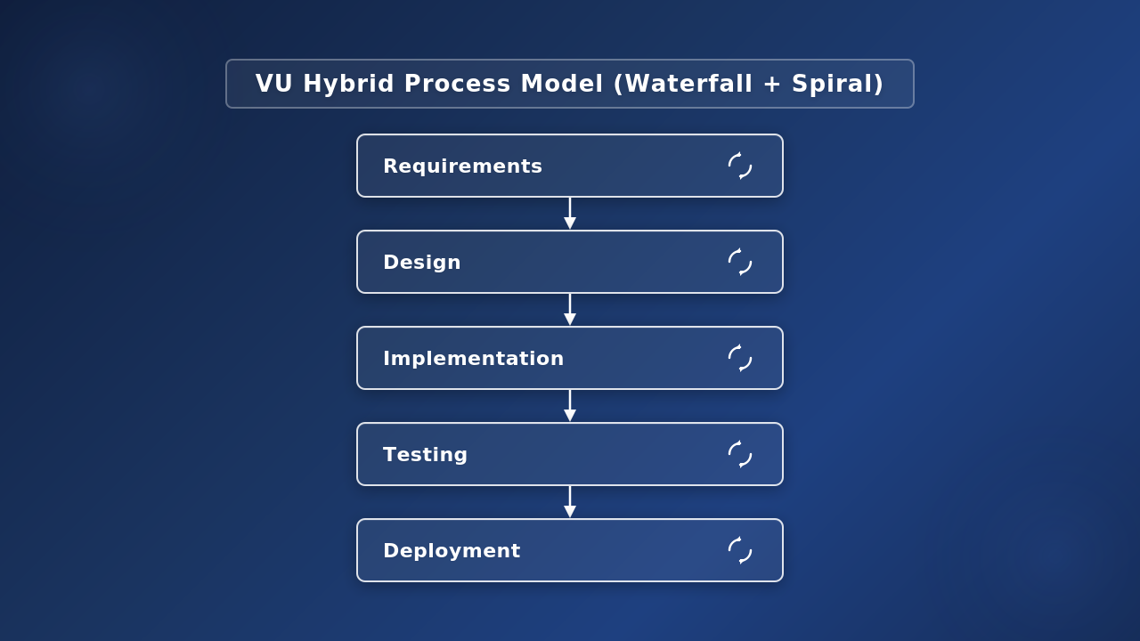
Process Model
Why Selected?
Structured documentation
Suitable for AI experimentation
Supports iterative ML improvement

Slide 7
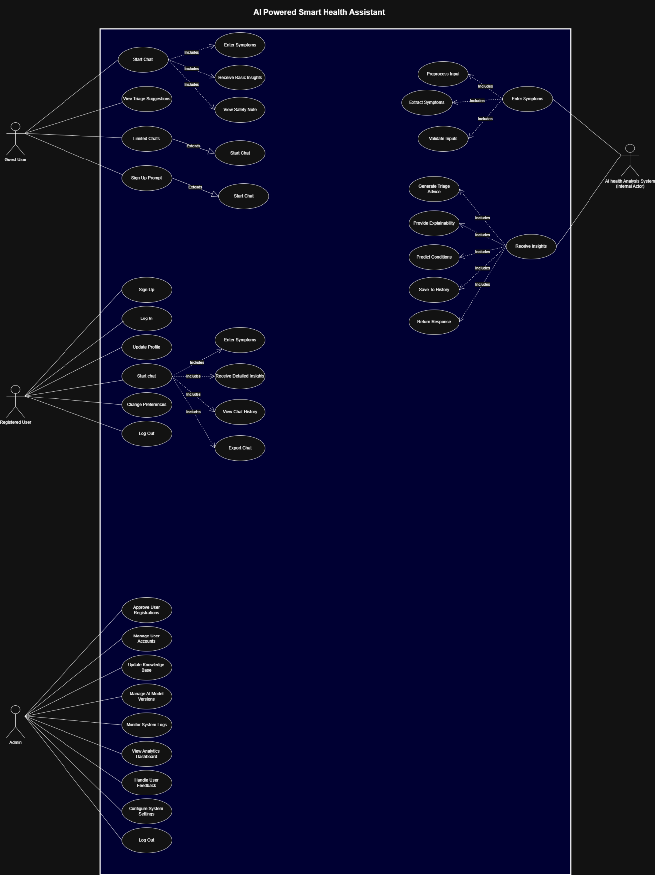
Use Case Diagram
Actors
Guest User
Registered User
Admin
AI Health Analysis System

Slide 8
Business Rules Catalog
Core Functional Requirements
Symptom input through text and voice
AI-based condition prediction
Triage recommendation
Specialist suggestion
Consultation history
PDF report generation
Admin analytics dashboard
English and Urdu support

Slide 9
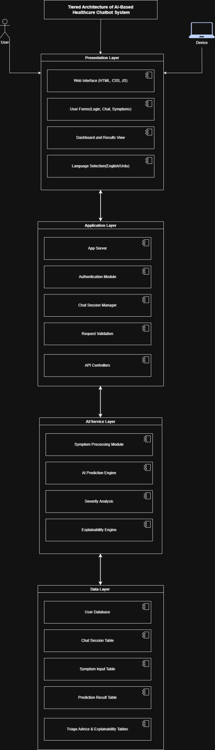
Architectural Design
System Architecture
React frontend
FastAPI backend
ML prediction engine
SQLite database
Explainability module

Slide 10
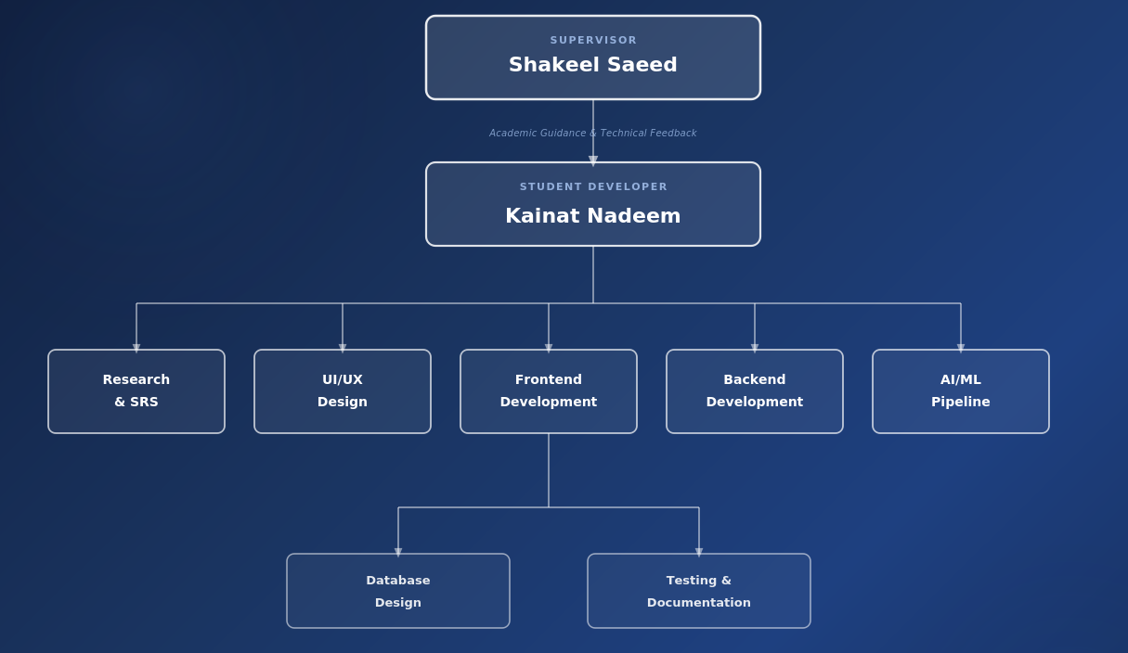
Project Role Distribution

Slide 11
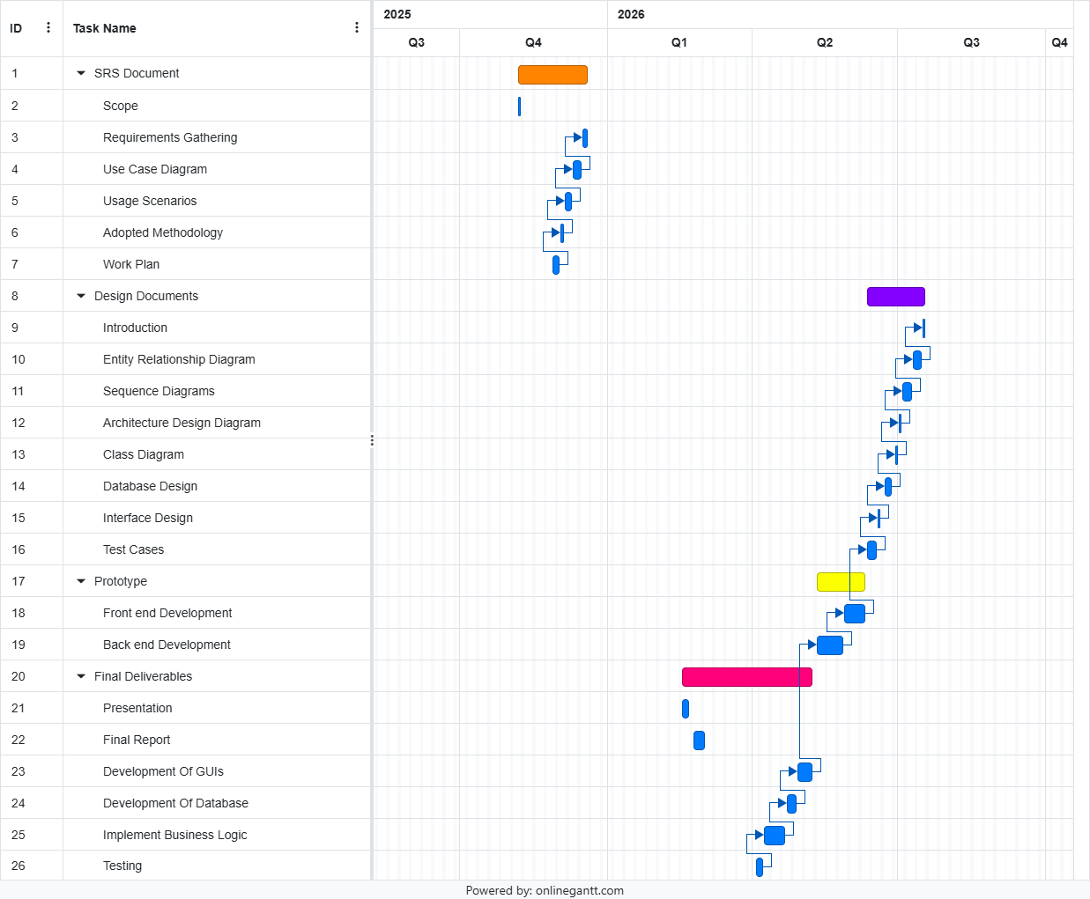
Project Schedule
Project completed in planned development phases
from research to final deployment.

Slide 12
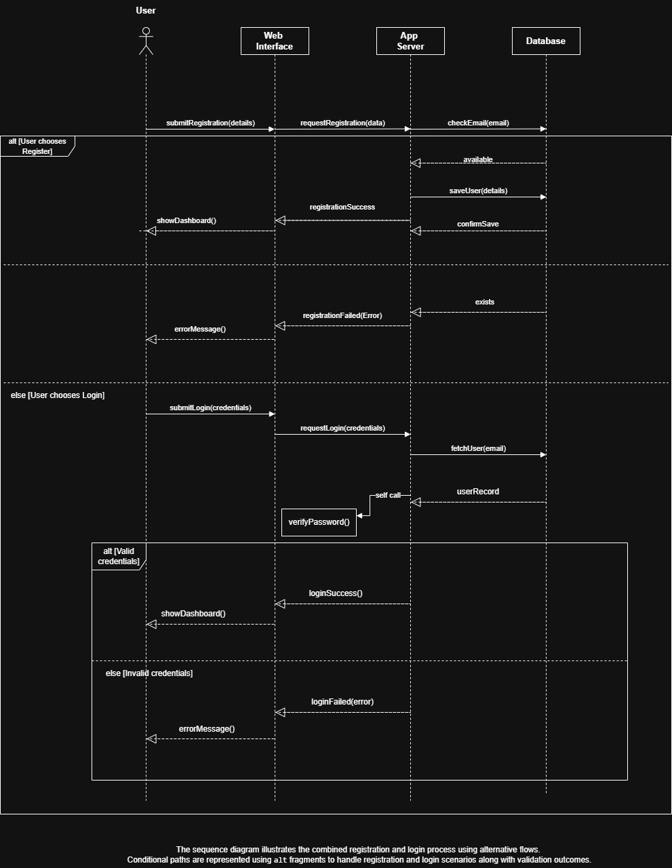
Sequence Diagram#01
Registration + Login

Slide 13
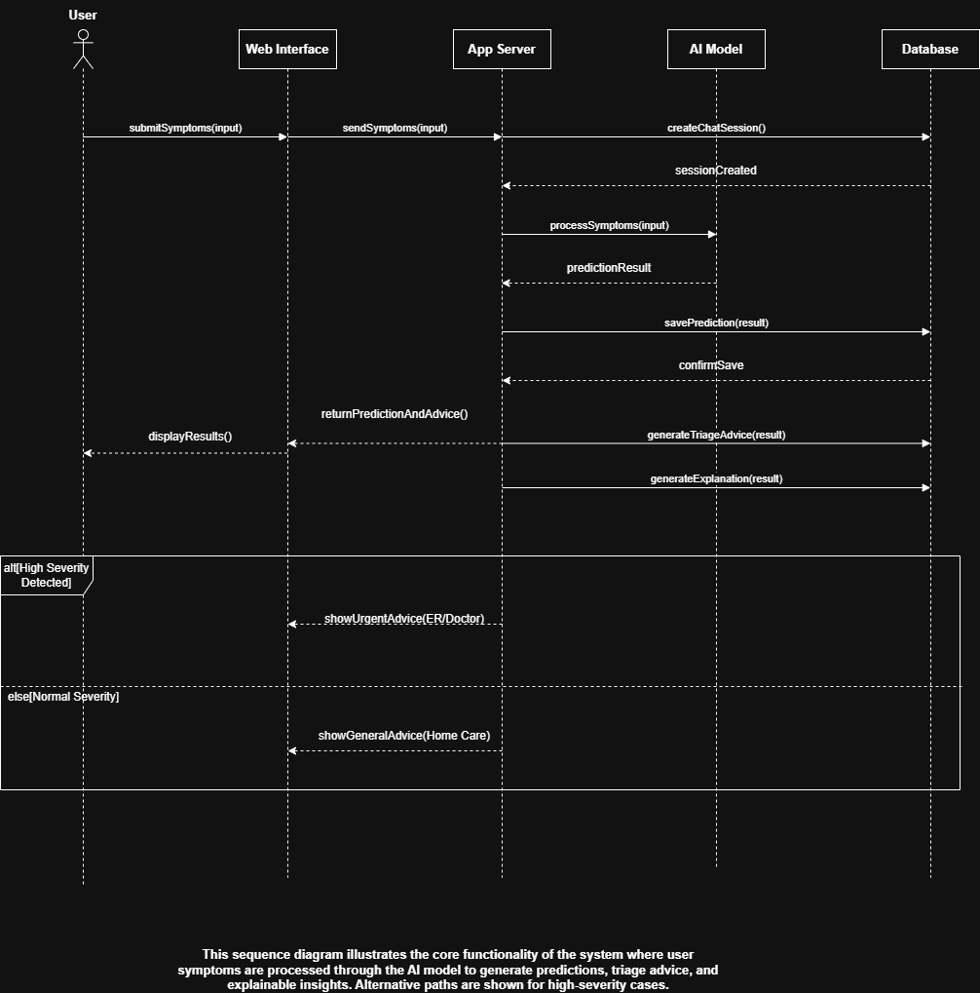
Sequence Diagram#02
Symptoms → AI Prediction

Slide 14
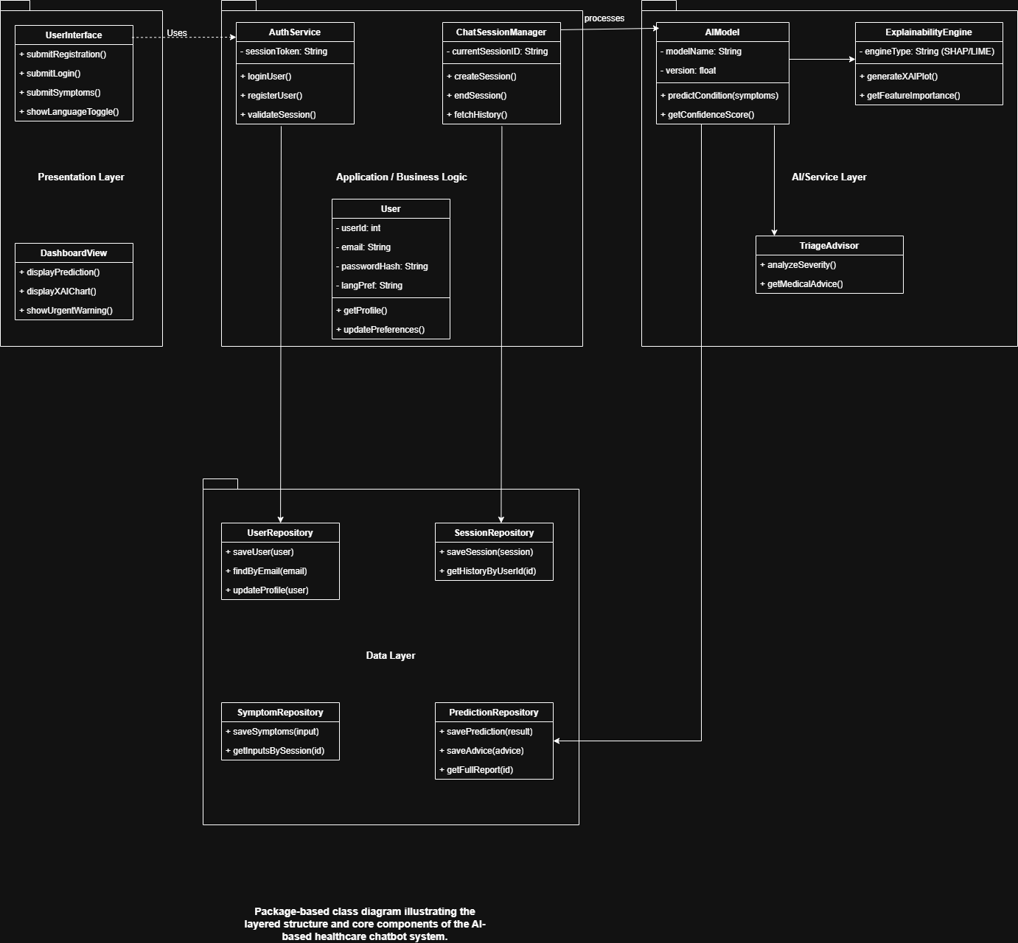
Logical Model/Class Diagram
Represents core entities
Shows system relationships
Supports modular design

Slide 15
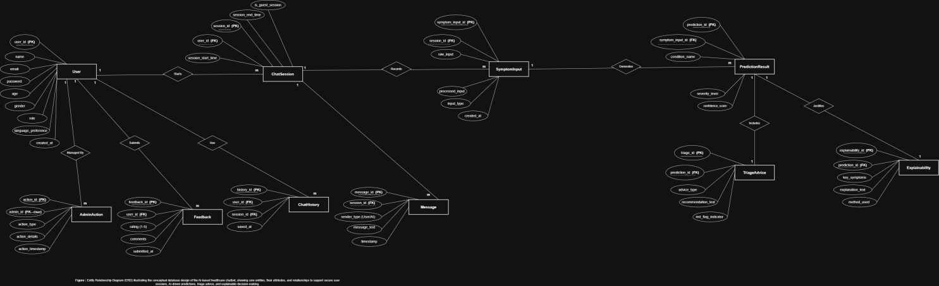
Entity-Relationship Diagram
Key Tables:
Users
Consultations
Feedback

Slide 16
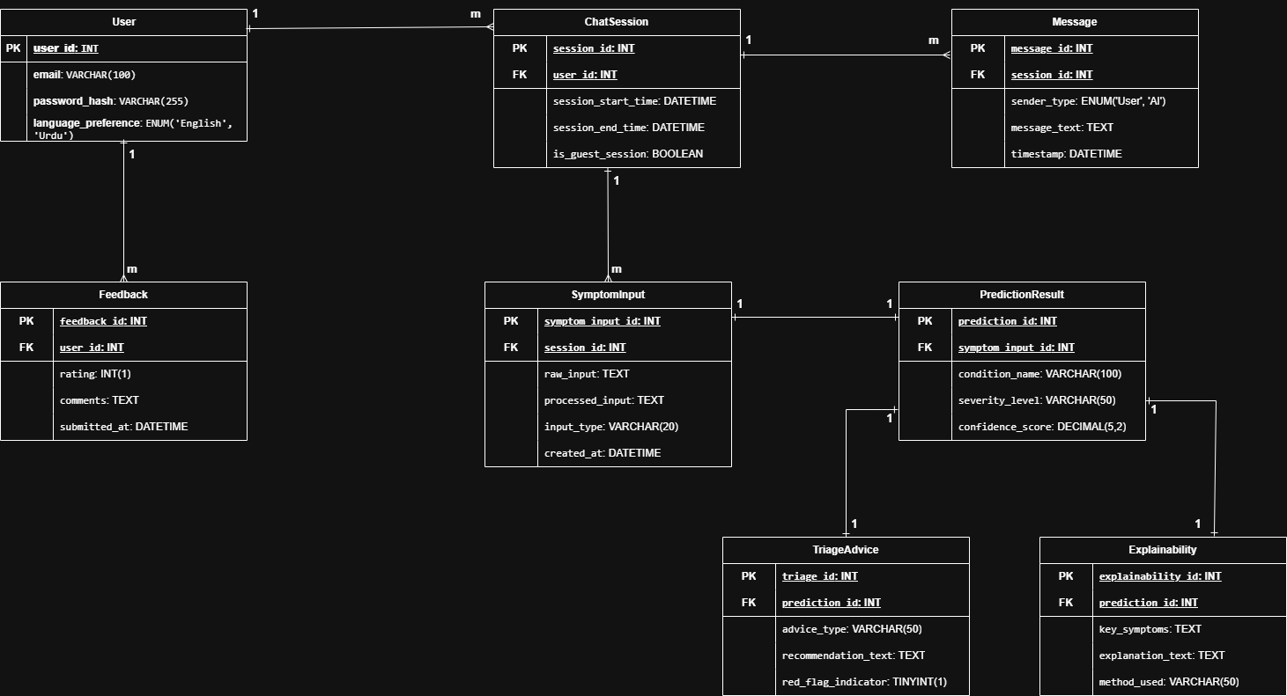
Database Diagram
Key Tables:
Users
Consultations
Feedback

Slide 17
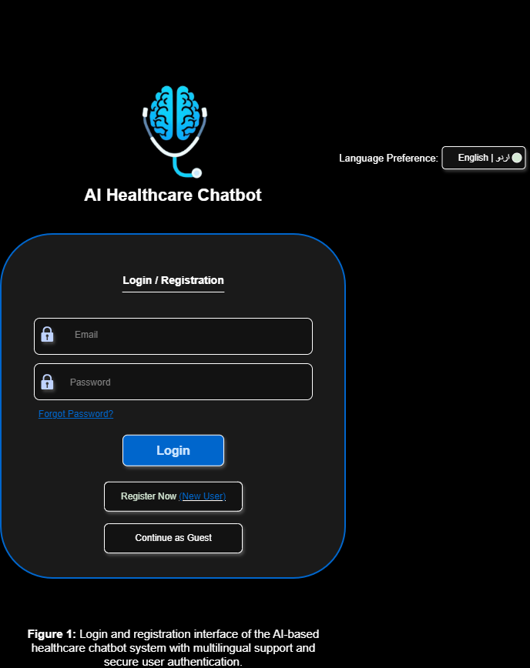
User Interface#01

Slide 18
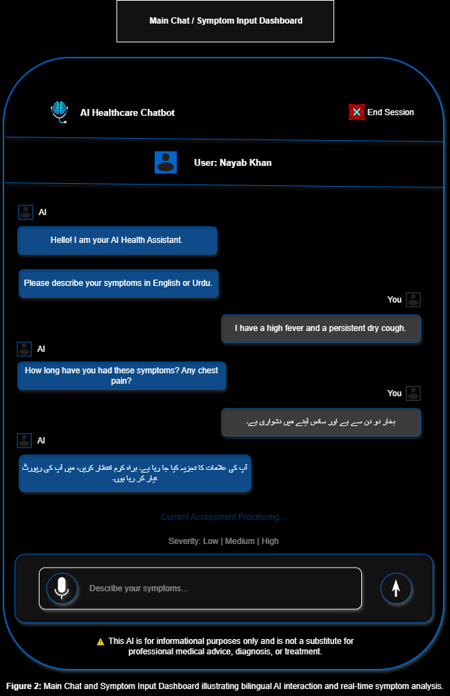
User Interface#02

Slide 19
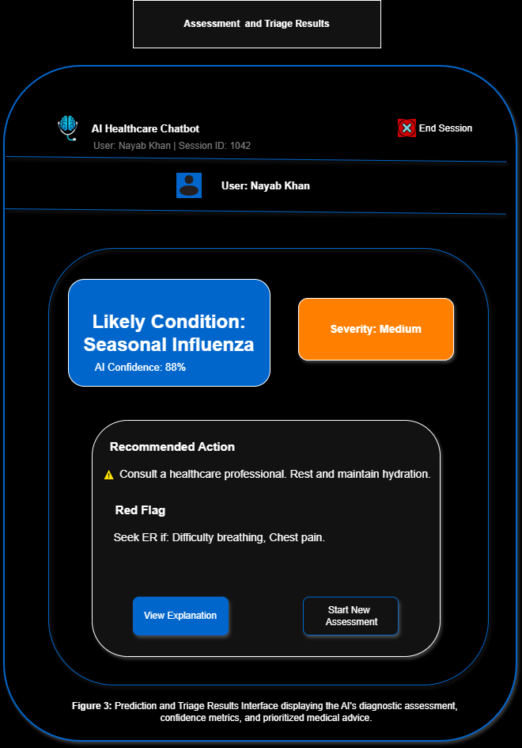
User Interface#03

Slide 20
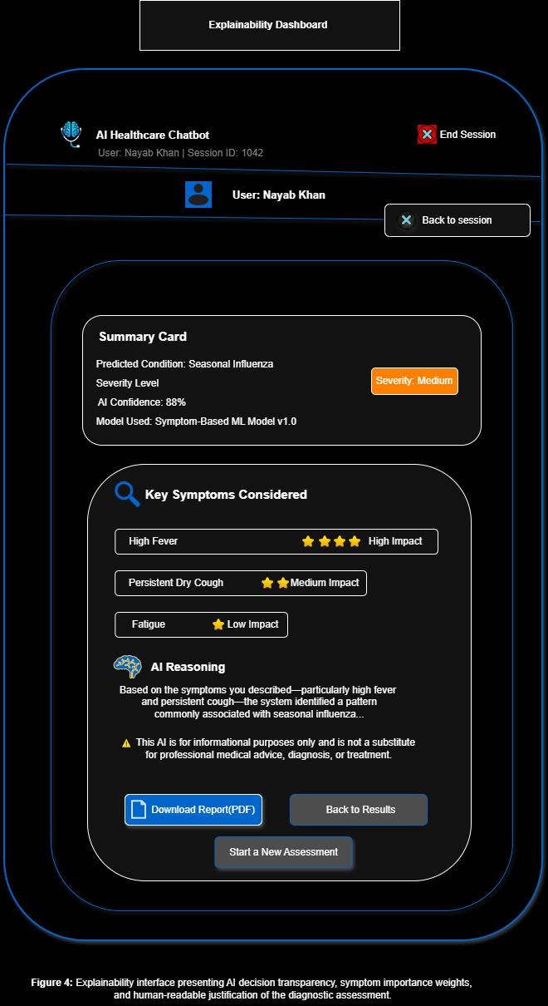
User Interface#04

Slide 21
Tools
Frontend
React
TypeScript
Tailwind CSS
Backend
FastAPI
Python
SQLite
AI/ML
Scikit-learn
NLTK
TF-IDF
Development Tools
VS Code
GitHub
Postman

